Slide 1
Verification of in-ear EEG
20160329 신동호

Slide 2
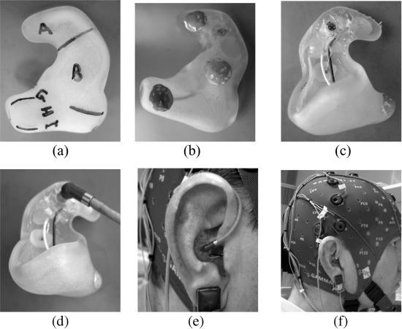
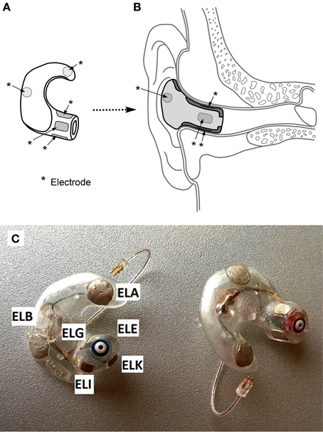
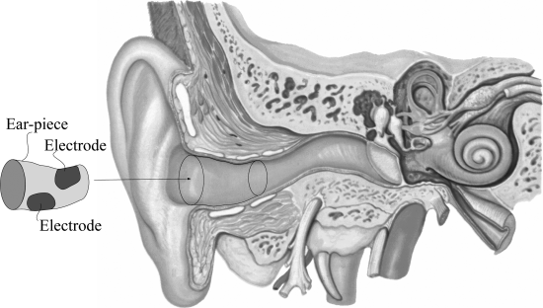
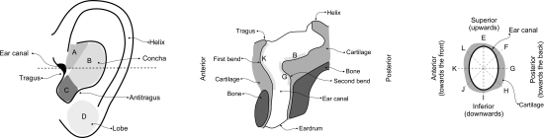
Devices
Individual modeling
Ref: ExA, GND: ERB
Ref: ExH, GND: ExA
Notes:
대체적인 추이는 보청기처럼 wax 등을 통해 본을 따고, 그 후 3D scanne와 CAD를 통해 모델링 한 후 3D printin하여 individua하게 desig하는 쪽임
둘 모두 wet electrode
Electrode도 concha 쪽에 둘, canal 쪽으로는 2~4개 정도.
깊숙한 고막까지 들어가는 정도는 안 보임. 하지만 고막 쪽으로 들어갈 수록 bone이 thicker해지는 구조.
우측 silver electrode A,B,H,E
만약 ear EEG만 사용하는 경우 하나는 GND, 하나는 Ref로 사용되기 떄문에 부착한 전극의 개수-2 만큼만 기록 가능함
Amplitude가 낮은 이유 1. electrodes 간 거리가 짧기 때문 2. Brain과 ear canal 간의 bone structure가 brain과 surface of the scalp보다 두껍기 때문

Slide 3
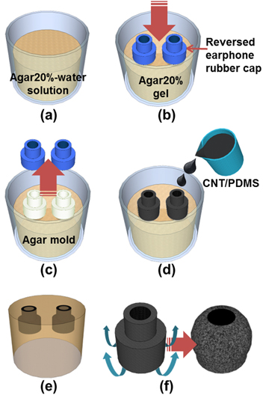
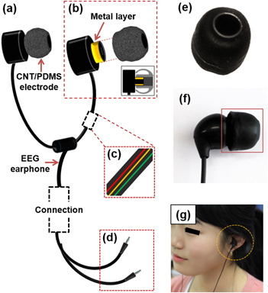
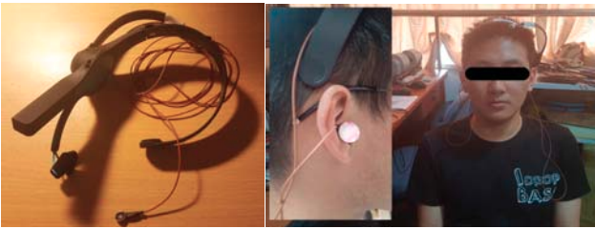
Devices
Universal modeling
Notes:
CNT/PDMS는 scalp EEG의 보조적인 역할로만 만듦, reference는 scalp EEG와 동일한 듯 (논문에 자세한 서술 없었음)
좌측 Dry electrode를 사용함 우측 low-cost ear-EEG라는데 아직 자세히 안 찾아봄
(a) The preparation of a 20% solution of agar in water. (b) The placement of earphone rubber caps into the agar gel. (c) The removal of the earphone rubber caps after the agar gel had fully solidified. (d) The pouring of the CNT/PDMS into the agar mold. (e) The removal of the agar mold after the CNT/PDMS had cured. (f) By inverting the CNT/PDMS electrode, we can get the completed CNT/PDMS-based CEE cap.

Slide 4
Electrodes
Materials
Ag, AgCl, CNT/PDMS
Electrodes location
One vs. Multiple
Supporting scalp-EEG vs. Independent ear-EEG
Reference location
Reference electrode는 자유롭게 변경 가능
Cross-referenced
Scalp의 경우 Cz나 ear lobe가 refer, ERB나 ear lobe가 GND
Reference placed outside the ear
Gel-based artifacts
How to verify in-ear EEG reference?
Cross-talk by sound tube
Amplitude-modulated makes frequency band became much higher compared to EEG band
Notes:
Cross-referenced 반대편 귀에 있는 모든 전극을 평균냄으로써 얻음
Refercne를 local ExA로 사용하는 경우 ERP 차이가 나는데, 짧은 전극 거리가 증폭시키는 좌반구와 우반구의 해부학적 차이로 보고 있음
Reference는 귀 밖에 두어서 젤의 영향 최소화
Cross-talk: However, when the sound signal was amplitude-modulated, its frequency band became much higher (beside the carrier frequency) compared to the EEG band, so cross-talk could be ignored, although cross-talk was observed in the EEG signal.

Slide 5
Verification
Ear-referenced vs. Scalp-referenced
CNT/PDMS vs. Conventional
Steady-state response & Transient Response

Slide 6
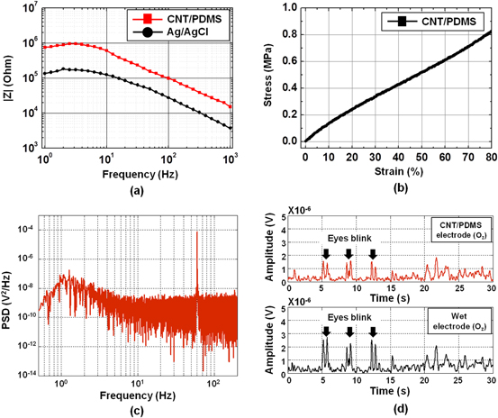
Electrical and mechanical performance test (CNT/PDMS)
Impedance
Wet electrodes require <5kΩ
1 to 1000 Hz
Decreased as frequency increased
1MΩ at <5Hz
Most artifacts <5Hz
Ag/AgCl; 300kΩ at <4Hz
Similar SNR
Young’s modulus
Tensile stress-strain curve
1MPa
Notes:
The contact impedance was calculated by subtracting the four-electrode impedances from the three-electrode impedances at each frequency between 1 to 1000 Hz.
. EMI(electromagnetic interference)는 electrical shielded wire를 사용함으로써 무시된다고 봄
30Hz에서 감지된 이유는 보통 주변의 전자기기 때문인 경우가 많은데, 텅 빈 방을 빌리는 것도 괜찮을듯

Slide 7
EEG verification paradigm
Paradigm
Auditory Steady-State Response (ASSR) O
Spectrogram for visualize, SNR for quantification
Mismatch Negativity (MMN) paradigm
α-attenuation paradigm (Alpha wave detection) O
N100 Auditory evoked potential (N100 AEP)
Steady state visually evoked potential (SSVEP) O
Transient Response (<-> Steady-State Response)
Transient Auditory Evoked Potential <-> ASSR
Transient Visual Evoked Potential <-> SSVEP
Notes:
AAR: alpha attenuation response
Signal-to-noise ratio (SNR)
이런건 eeglab 통해 matlab으로 이동 후 내가 할 수 있음

Slide 8
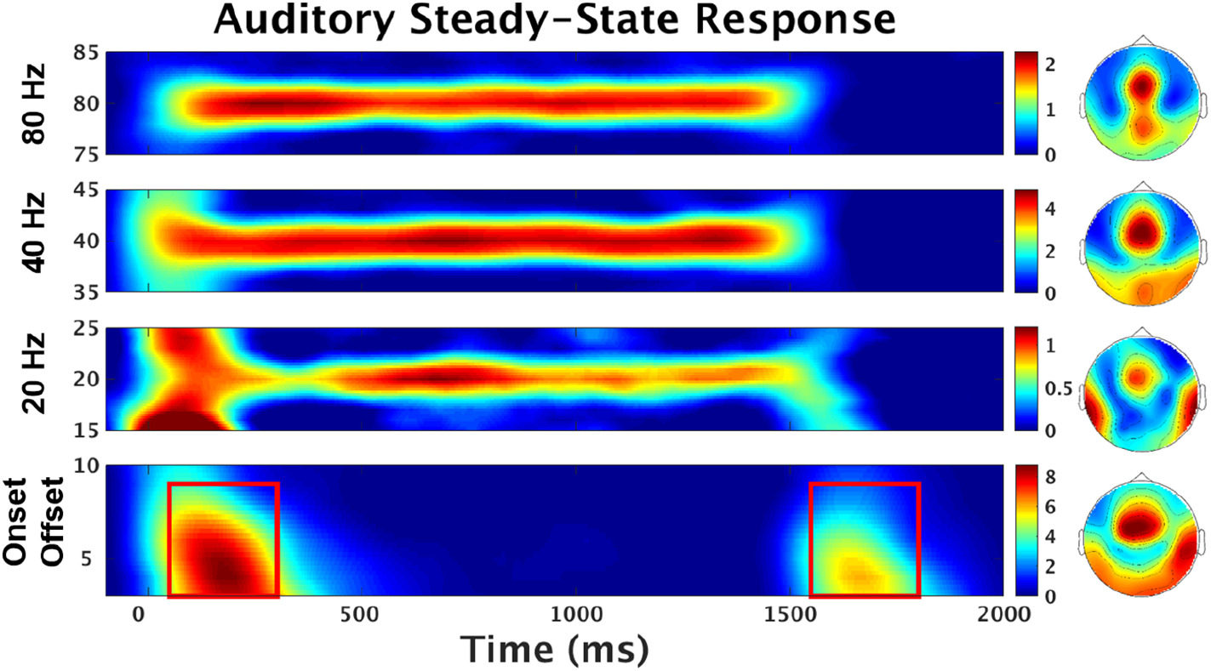
EEG Measurements (Method)
ASSR
White noise (Amplitude modulation 40Hz) presented binaurally for 4 min
Aligned by 20Hz trigger
Electrode rejection의 기준
Visualization with spectrogram
Quantification with SNR
Notes:
CNT/PDMS에서는 37Hz, 43Hz

Slide 9

EEG Measurements (Method)
MMN
Oddball paradigm
Beep sound
Sinusoidal tones of 500, 1000, and 1500 Hz lasting 75ms
Oddballs
Low/high pitch, low/high volume, left/right delay, reduced duration, gap
Electrode rejection의 기준

Slide 10
EEG Measurements (Method)
α-attenuation paradigm
Rest with closed eyes
Simple arithmetic in the head with open eyes
10초마다 바뀌는 50-100 사이의 수에서 7을 뺌
1min interval
Alpha wave detection
Only close and open eyes with 10s
Notes:
Open eyes에서 문제를 푸는 경우도 있고, 그냥 눈만 뜨고 있는 경우도 있음

Slide 11
Data Preprocessing (Electrode Rejection)
Channels which did not have a clear 40Hz peak in the ASSR
“clear” – 9dB amplitude-difference relative to noise floor
Channels which did not have a similar shapes in the mismatch response
Cz-referenced mismatch responses in ear electrodes
Cz-referenced TP9 and TP10 (Auditory signal)
Single-electrode reference
Average 사용시 electrode rejection 개수 차에 의한 weight 변동

Slide 12
EEG Measurements (Method)
N100 AEP
Dominant negative peak of an EEG after one shot of auditory stimulation
1kHz 500ms 90dB repeated 100 times for 3 mins
Random intervals 1-1.5s
Prevent adaptation
Band-pass filtered 2-20Hz by 3rd-order Butterworth filter

Slide 13
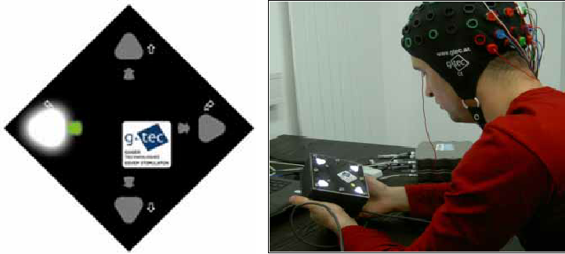
EEG Measurements (Method)
SSVEP
Flashes of LED (~75Hz)
Most sensitive 10Hz
14Hz, 50% duty cycle
30s stimulation, 10s interval
Dark, silent room

Slide 14
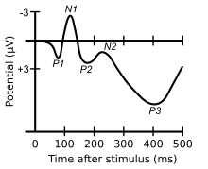
EEG Measurements (Method)
Transient Auditory Evoked Potential
P1-N1-P2 complex
Auditory cortex
1kHz sinusoid of duration 200ms
Attack and release time of 10ms
Random interstimulus interval 1.7-2.3s
Notes:
Interstimulus interval을 랜덤으로 증가시켜야 하는 이유: 시간이 어느 정도 지나도 남아있는 ERP 신호가 averaging으로 인해 발생할 수 있는 distortion을 방지하기 위함 lower frequency 얼라이어싱 방지

Slide 15
EEG Measurements (Method)
Transient Visual Evoked Potential
Visual evoked potential (VEP)
Primary visual cortex
5ms duration
Random interstimulus interval uniformly distributed between 300-500ms

Slide 16
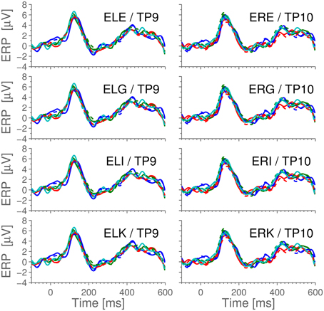
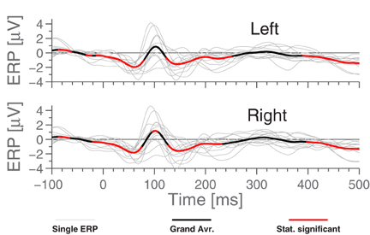
Ear-referenced vs. Scalp-referenced (Results)
MMN
Cz-referenced ERP
150ms peak
Correlation coefficient between scalp and ear 0.977
Notes:
Cz-referenced를 통해 ear에서 측정이 잘 되는지 scalp와 비교
Full lines –scalp dashed –ear
Different color –different sessions

Slide 17
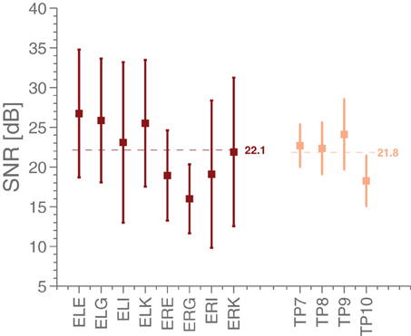
Ear-referenced vs. Scalp-referenced (Results)
ASSR
Cz-referenced
SNR
Logarithm difference between the signal and the noise floor
Ear and scalp SNR are similar
Left>Right
Notes:
SNR; difference between the logarithm of the power at 40 Hz (the signal) and the logarithm of the average power in 5 Hz intervals around 40 Hz (the noise floor)

Slide 18
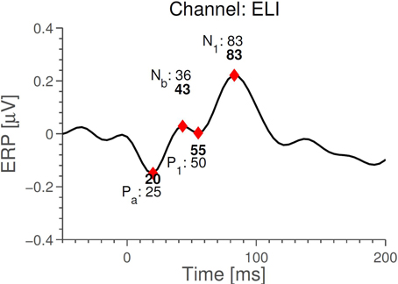
Ear-referenced vs. Scalp-referenced (Results)
MMN
Ear-referenced ERP
No meaningful difference with oddball paradigm
“Cross-referenced” slightly increase amplitude
Middle latency deflections
From 8~10 ms to 50~80ms
Precision 4ms (256Hz)
기기 sampling rate에 따라 관측 힘들 수도 있음
Opposite polarities
Notes:
Ear-reference를 사용한 결과 MMN oddball에서는 0과 유의한 차이 X
->MMN의 frontal sourc가 primary auditory cortex보다 귀에서 더 멀고, electrode아 reference가 가까울 때 source로부터의 거리와 진폭이 거리의 세제곱에 반비례하기 때문
Middle latency deflection medium latency AEP

Slide 19
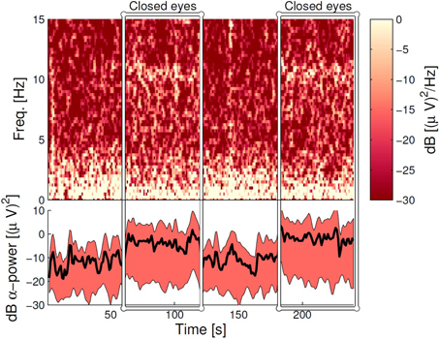
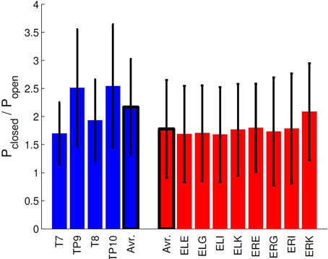
Ear-referenced vs. Scalp-referenced (Results)
α-attenuation paradigm
Ear-referenced
Distinguishable
Quantification with average ratios of alpha power
Notes:
왼쪽은 time domain으로 시각화 한 것
Bar graph는 보다 정량화 한 것

Slide 20
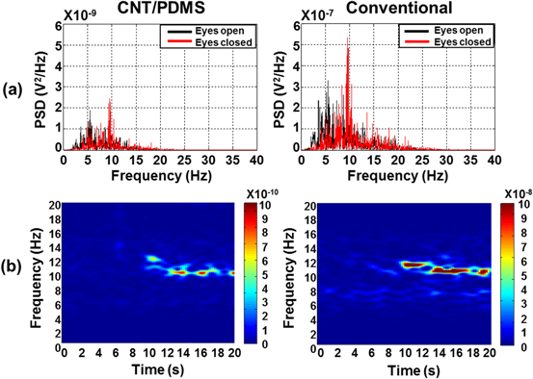
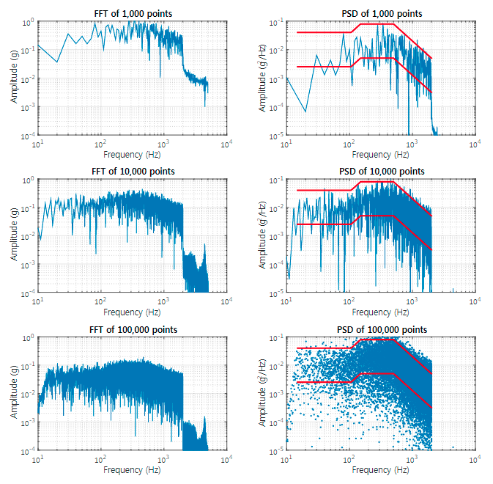
CNT/PDMS vs. Conventional (Results)
Alpha rhythm detection
Scalp-referenced
Attached on Oz
PSD>FFT
Frequency domain
Dominant peak 10-12 Hz (Eye closed)
Time domain
>10s
SNR of CNT/PDMS and conv
Similar
Notes:
Alpha band 8-14 Hz
Oz가 아닌 귀에 부착시 귀에 부착 시 Alpha rhythm signals가 filtering 없이는 time domain에서 유의미한 결과 없었음. -> Oz와 비교하여 진폭이 아주 낮은 이유-> 귀에선 alpha activity가 너무 낮기 때문. 더욱이, N100 AEP와 SSVEP는 성공적으로 측정됨.
Power Spectral Density가 정현파가 아닌 랜덤파 분석에서는 FFT보다 좋음
Absolute value가 Conventional이 높지만, SNR은 비슷
Mean PSD of alpha로 정량분석 가능

Slide 21
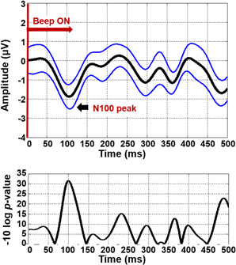
CNT/PDMS vs. Conventional (Results)
N100 AEP
CNT/PDMS
N100 peak at 80-120ms
T-test
P<0.01

Slide 22
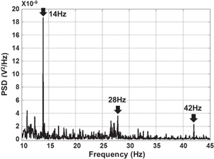
CNT/PDMS vs. Conventional (Results)
SSVEP
CNT/PDMS
14Hz stimulus
Dominant peak at 14 Hz
Sub-harmonic 28, 42Hz

Slide 23
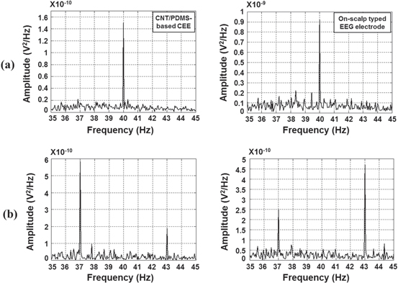
CNT/PDMS vs. Conventional (Results)
ASSR
40Hz ASSR
Dominant peak at 40Hz
CNT/PDMS has higher SNR
Binaural beats 37Hz & 43Hz
Selective attention
Depends on which side subjects focus on

Slide 24
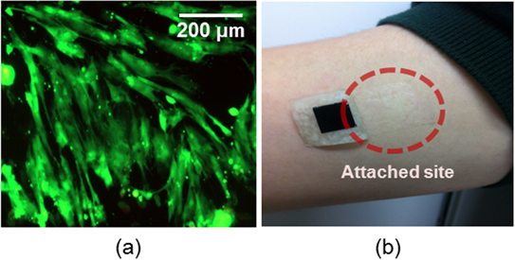
(Option) Biocompatibility
Cell viability
Cultured on the CNT/PDMS surface for 7 days
>93% skin fibroblast cells
Control dishes >99%
Attachment of the PDMS/AgNW sheet to the skin
Air-permeable tape
7 days
No adverse effects
Erythema or urticarial
Comfort survey
Notes:
1. Cytoxicity of the electrode materials by culturing skin firbroblast cells on the CNT/PDMS. Dulbecco's modified Eagle medium (Gibco) seven days. Viability - Live/dead assay kit. Stain – inverted fluorescence microscope.
2. Skin compatibility – itching, swelling, or redness. CNT/PDMS sheet was attached to the upper arm with air-permeable tape. 7 days.
erythema or urticarial 홍반, 두드러기

Slide 25
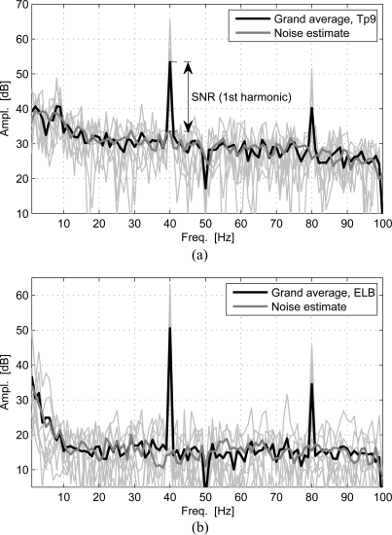
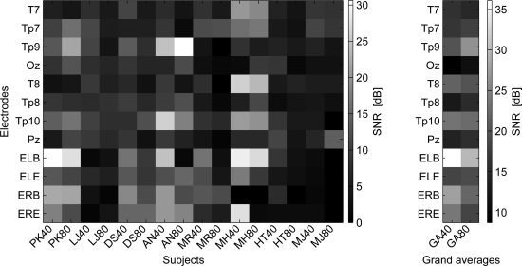
Steady-state response & Transient Response (Results)
ASSR
Ear-EEG has higher SNR
Notes:
right ear lobe를 ref, Cz를 GND로 사용

Slide 26
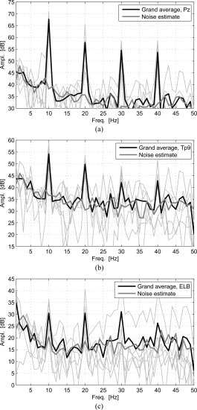
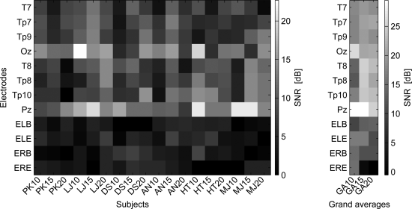
Steady-state response & Transient Response (Results)
SSVEP
10Hz dominant peak
Subharmonics 20, 30, 40 Hz
SNR
Pz 30dB
Tp9 17dB
ELB 10dB

Slide 27
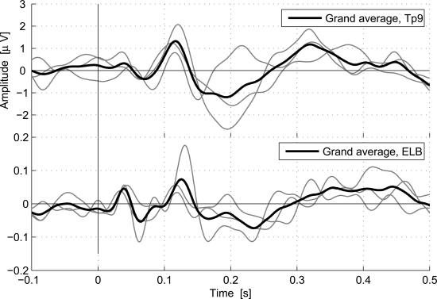
Steady-state response & Transient Response (Results)
Transient Auditory Evoked Potential
P1-N1-P2 complex
Similar ERP waveforms

Slide 28
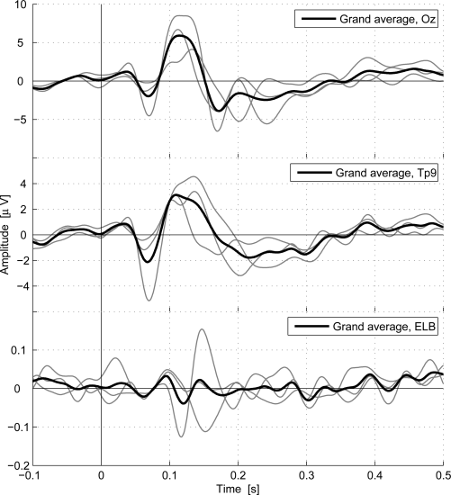
Steady-state response & Transient Response (Results)
Transient Visual Evoked Potential
Visual evoked potential (VEP)
Oz, Tp9, ELB
Ear-EEG amplitude is 20dB lower
Similar ERP waveforms
Notes:
Ear-EEG가 scalp보다 20dB 정도 낮음. 하지만 중요한 건 파형이 비슷한 것. 논문에서는 파형이 비슷하다고 말했지만 개인적으로는 그렇게 보이지 않는다고 생각함. Transient VEP에서 SNR에 대한 이야기는 없음.

Slide 29
Emotion recognition
Previous target stimulus
Auditory
Visual
Our target cortex
Deep brain
Emotion

